Slide 1
Lecture 29

Slide 2
Question 123.8.10.2
What might be the problem with calibrating your Celsius scale thermometer here in Rexburg, ID?
No problem, the Celsius scale is well established
Because it is so cold here, you might drop the thermometer while you work on it.
Water does not boil at 100 °C here
The scale does not work well for temperatures outside the 0 °C to 100 °C range.

Slide 3
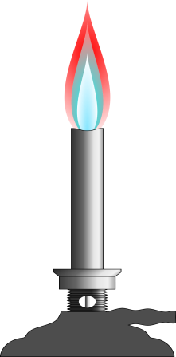
100°C
0°C

Slide 4
Temperature from the Zeroth Law
Two objects in thermal equilibrium with each other are at the same temperature
Temperature is the property that determines whether or not an object is in thermal equilibrium with other objects

Slide 5
Question 123.8.10.3
The pressure in a constant-volume gas thermometer extrapolates to zero at what temperature?
0°C
0 K
0°F
0 Pa

Slide 6
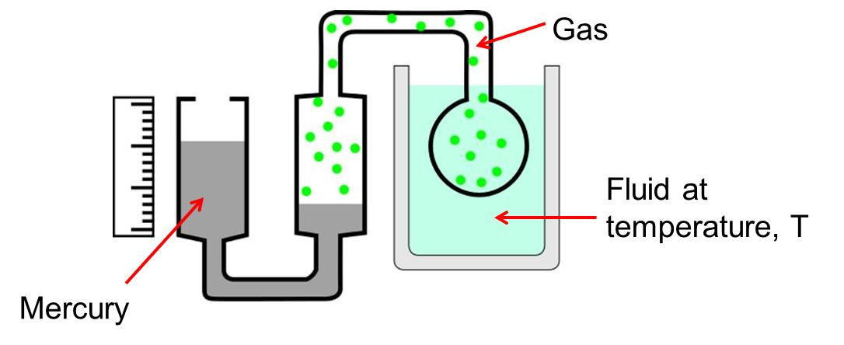
Question 123.8.10.4
We have a complicated gadget as shown. At points C and D
The pressure is the same
The pressure at point D is larger
The pressure at point C is larger
You can’t tell unless you know the pressure of the gas
C
D

Slide 7
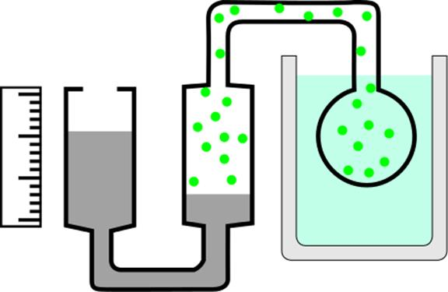
Gas
A
Fluid at temperature, T
B
Mercury

Slide 8
P (Pa)
Temperature (°C)
-200
-100
0
100

Slide 9
P (Pa)
P = 0 Pa
T = -273 °C
Temperature (°C)
-200
-100
0
100

Slide 10
P (Pa)
P = 0 Pa
T = 0 K
Temperature (°C)
-200
-100
0
100

Slide 11
10⁹
10⁸
10⁷
Solar Interior
10⁶
10⁵
10⁴
Solar “surface”
10³
Copper Melting Point
10²
Water Freezes
Liquid Nitrogen
10
1
Liquid Helium

Slide 12
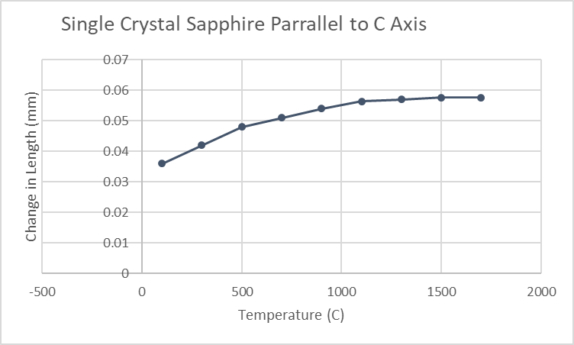

Slide 13
Material | Average α(K⁻¹)
Aluminum | 25×10⁻⁶
Copper | 17×10⁻⁶
Gold | 14×10⁻⁶
Lead | 29×10⁻⁶
Brass | 18.7×10⁻⁶
Steel | 11×10⁻⁶
Glass | 9×10⁻⁶
Concrete | 12×10⁻⁶

Slide 14
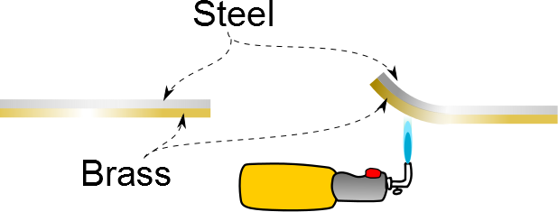

Slide 15
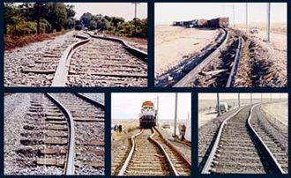

Slide 16
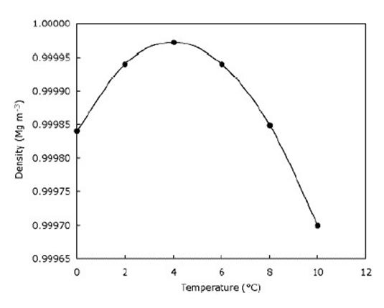

Slide 18
End

Slide 19
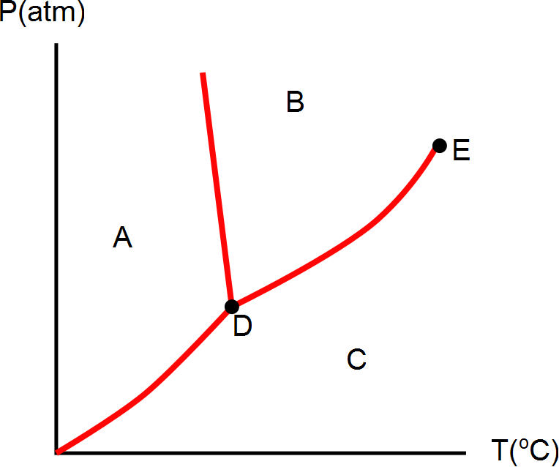
Question 123.8.11
What phase would this substance have if is were in the state represented by letter C?
Solid
Liquid
Gas
Plasma

Slide 23
Question 123.8.11
What phase would this substance have if is were in the state represented by letter A?
Solid
Liquid
Gas
Plasma

Slide 24
Question 123.8.11
What phase would this substance have if is were in the state represented by letter B?
Solid
Liquid
Gas
Plasma

Slide 25
Question 123.8.12
What is point D?
Sublimation point
Boiling point
Triple point
Double point
Critical point

Slide 26
Question 123.8.12
What is point E?
Sublimation point
Boiling point
Triple point
Double point
Critical point

Slide 27
Question 123.8.12
What do we call moving from region A to region B?
Boiling
Freezing
Melting
Condensing
Sublimation

Slide 28
Question 123.8.12
What do we call moving from region A to region C?
Boiling
Frezzing
Melting
Condensing
Sublimation

Slide 29
Question 123.8.12
What do we call moving from region B to region C?
Boiling
Frezzing
Melting
Condensing
Sublimation

Slide 30
Question 123.8.12
What do we call moving from region C to region B?
Boiling
Frezzing
Melting
Condensing
Sublimation

Slide 31
Question 123.8.12
What do we call moving from region B to region A?
Boiling
Frezzing
Melting
Condensing
Sublimation

Slide 32
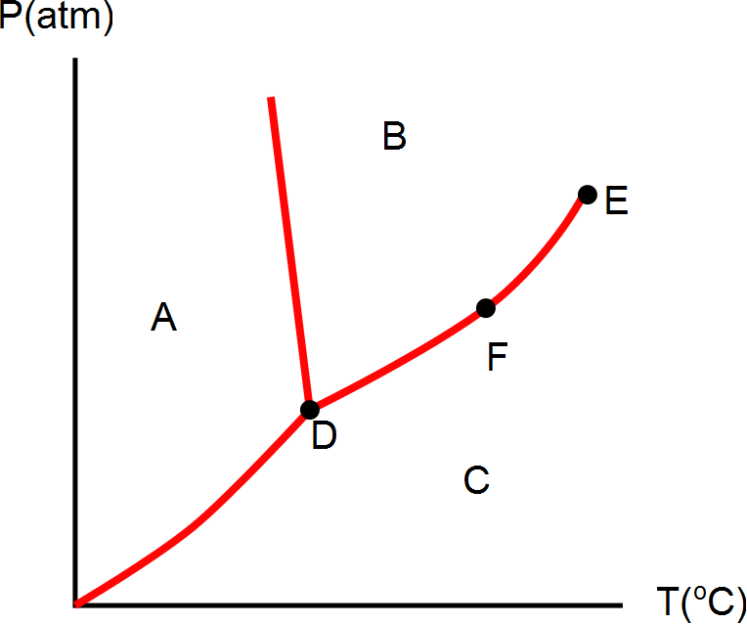
Question 123.8.12
What phase is the material at if it is in the state represented by letter D?
Solid
Liquid
Gas
Plasma
Can’t tell

Slide 33
Question 123.8.12
What can we say about the state represented by point F?
Solid
Liquid
Gas
Plasma
It is a phase equilibrium

Slide 34
[Figure] [More Complete Phase Diagram for Water (Public Domain Image courtesy Karlhahn)]

Slide 35
Question 123.13.1
Why is C_{P} larger than C_{V}?
It has to do with the spacing of molecules
It is because no work is done in a isovolumetric process
It is because no work is done in an isobaric process
Can’t tell

Slide 36
Question 123.13.2
How does the internal energy of an ideal gas change as it follows the red path upward?
Increases
Decreases
Stays the same
Can’t tell

Slide 37
Question 123.13.2.1
How does the internal energy of an ideal gas change as it follows the green path from left to right?
Increases
Decreases
Stays the same
Can’t tell

Slide 38
Question 123.13.2.2
For which path, red or green, does the internal energy of an ideal gas change the most?
Red isochoric
Green isobaric
Both the same
Can’t tell

Slide 39
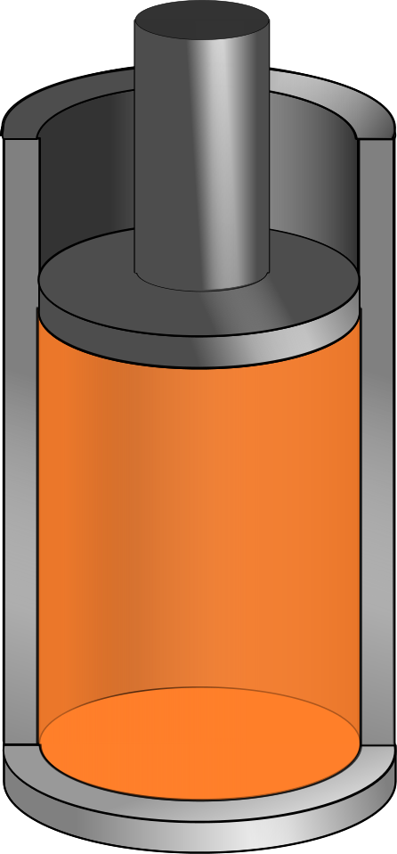
Δy
V
P
A

Slide 42
Question 123.13.3
For an adiabatic process PV^{γ} =….
A constant
nRT^{γ}
(nRT)^{γ}
Can’t tell

Slide 43
Question 123.13.4
Your home gets too cold in the winter. This is likely because you have too much
Convection
Conduction
Radiation
More than one of the above

Slide 44
Energy Transfer Mechanisms

Slide 45
Methods of Heat Transfer
Need to know the rate at which energy is transferred
Need to know the mechanisms responsible for the transfer
Methods include
Conduction
Convection
Radiation

Slide 46
Conduction
The transfer can be viewed on an atomic scale
It is an exchange of energy between microscopic particles by collisions
Less energetic particles gain energy during collisions with more energetic particles
Rate of conduction depends upon the characteristics of the substance

Slide 47
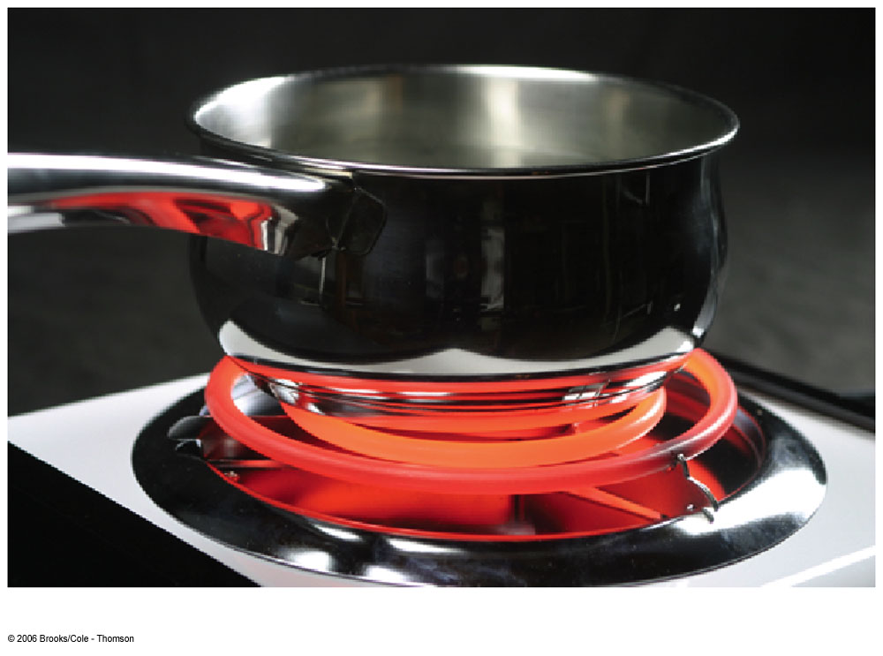
Conduction example
The molecules vibrate about their equilibrium positions
Particles near the stove coil vibrate with larger amplitudes
These collide with adjacent molecules and transfer some energy
Eventually, the energy travels entirely through the pan and its handle

Slide 48
Conduction, cont.
In general, metals are good conductors
They contain large numbers of electrons that are relatively free to move through the metal
They can transport energy from one region to another
Conduction can occur only if there is a difference in temperature between two parts of the conducting medium

Slide 49
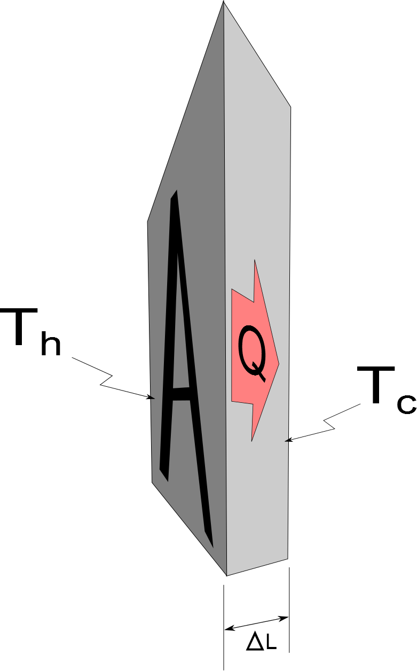
Conduction, equation
A
The slab allows energy to transfer from the region of higher temperature to the region of lower temperature

Slide 50
Conduction, equation explanation
A is the cross-sectional area
ΔL is the thickness of the slab or the length of a rod
P is in Watts when Q is in Joules and t is in seconds
k is the thermal conductivity of the material
See table 11.3 for some conductivities
Good conductors have high k values and good insulators have low k values

Slide 51
Home Insulation
Substances are rated by their R values
R = ΔL / k
See table 11.4 for some R values
For multiple layers, the total R value is the sum of the R values of each layer
Wind increases the energy loss by conduction in a home

Slide 52
Multiple Materials, cont.
The rate through the multiple materials will be
T_{H} and T_{C} are the temperatures at the outer extremities of the compound material

Slide 53
Convection
Energy transferred by the movement of a substance
When the movement results from differences in density, it is called natural conduction
When the movement is forced by a fan or a pump, it is called forced convection

Slide 54
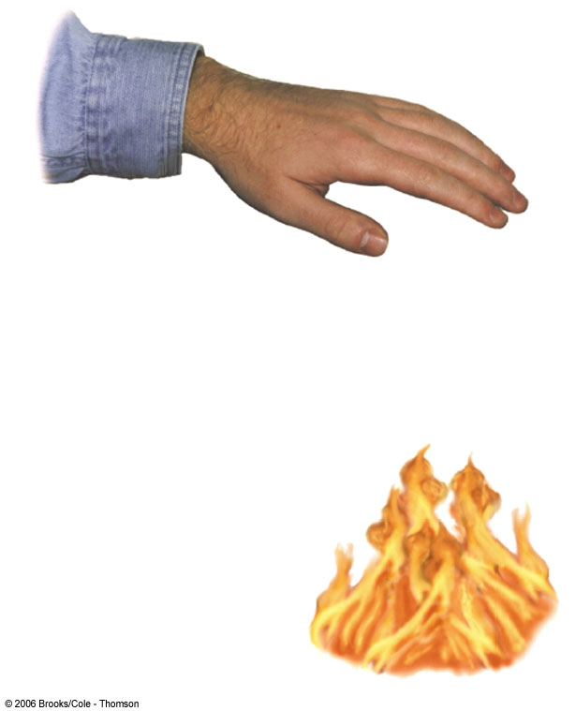
Convection example
Air directly above the flame is warmed and expands
The density of the air decreases, and it rises
The mass of air warms the hand as it moves by

Slide 55
Convection applications
Boiling water
Radiators
Upwelling
Cooling automobile engines
Algal blooms in ponds and lakes

Slide 56
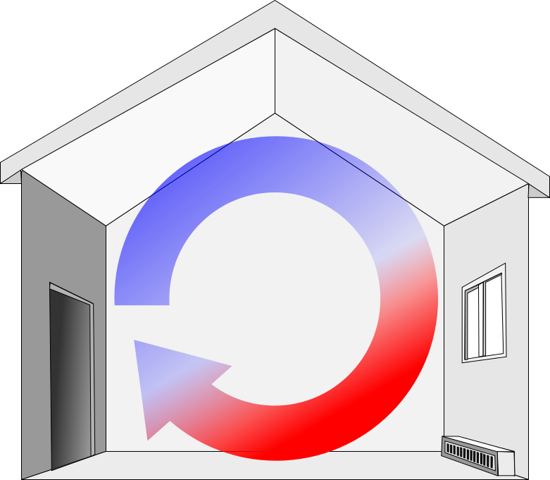
Convection Current Example
The radiator warms the air in the lower region of the room
The warm air is less dense, so it rises to the ceiling
The denser, cooler air sinks
A continuous air current pattern is set up as shown
Electric Base-Board Heater

Slide 57
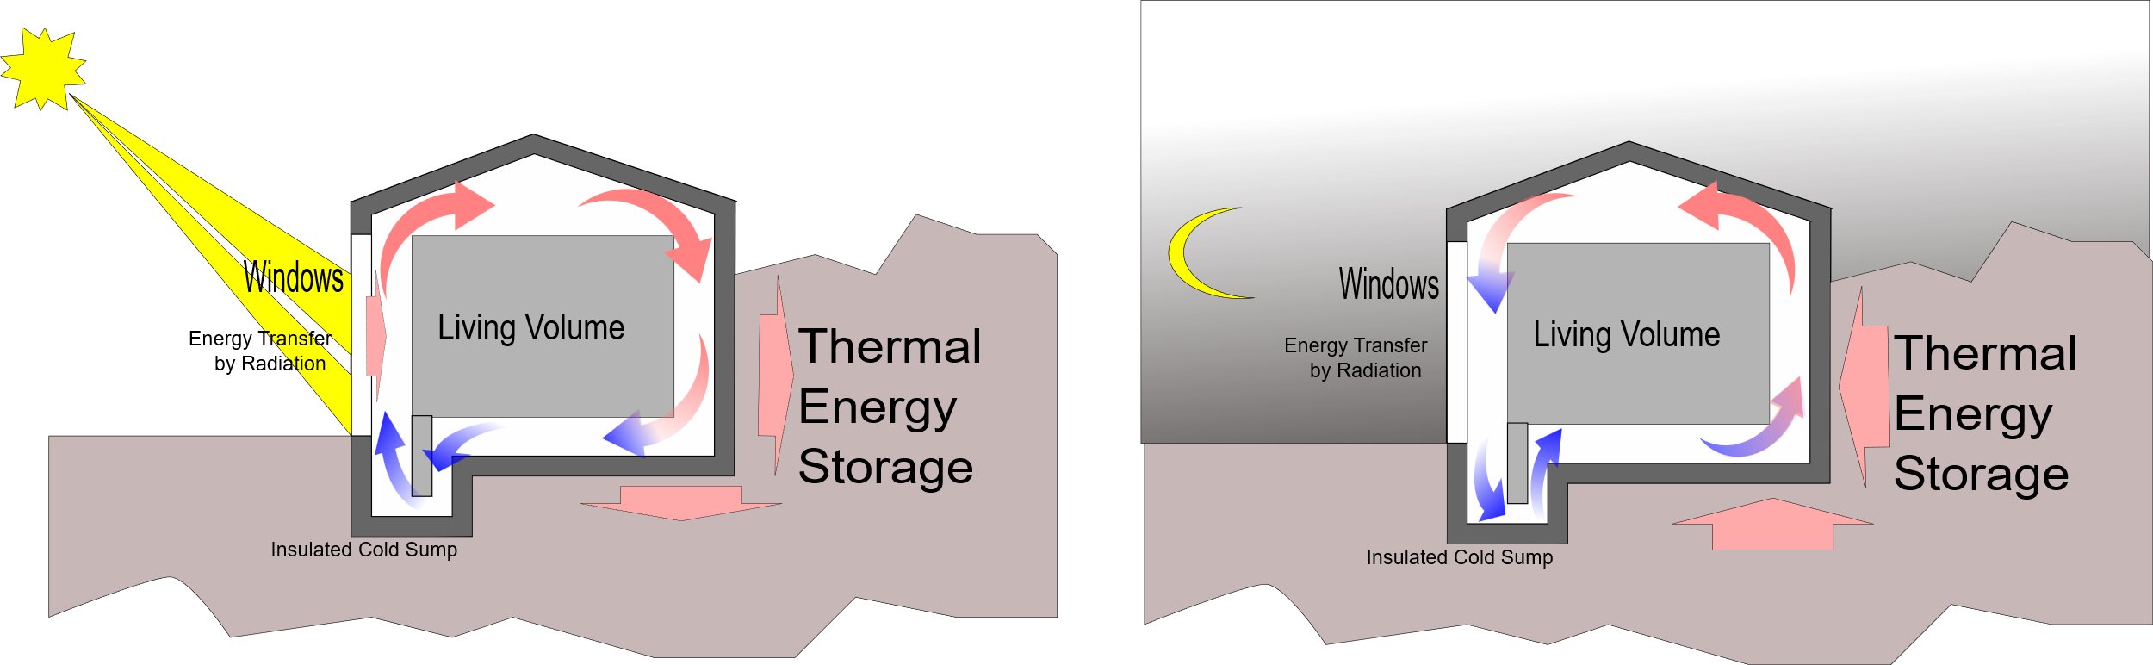
Passive Convection Heating

Slide 58
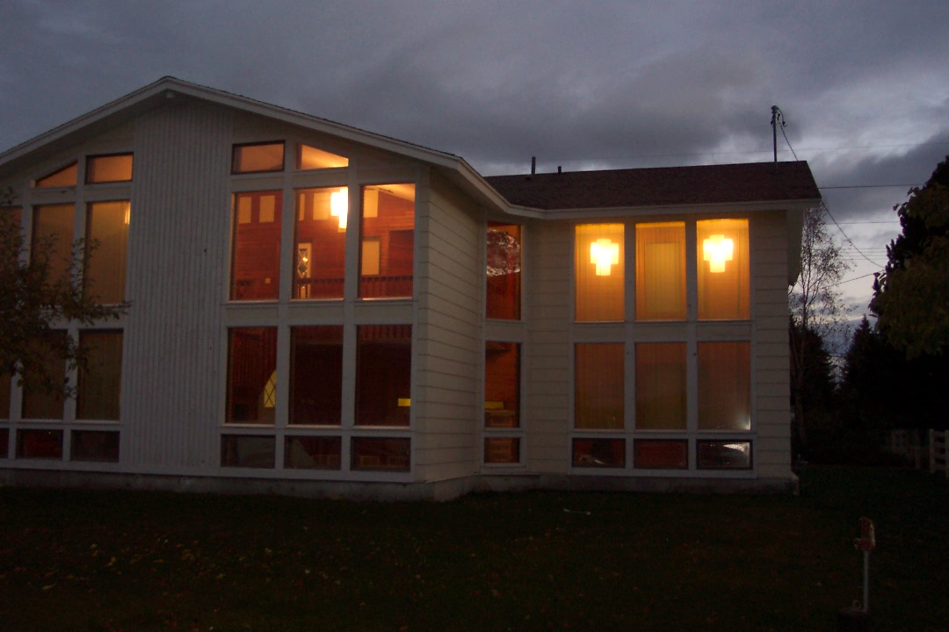
House Pictures

Slide 59

Upwelling

Slide 60
Radiation
Radiation does not require physical contact
All objects radiate energy continuously in the form of electromagnetic waves due to thermal vibrations of the molecules
Rate of radiation is given by Stefan’s Law

Slide 61
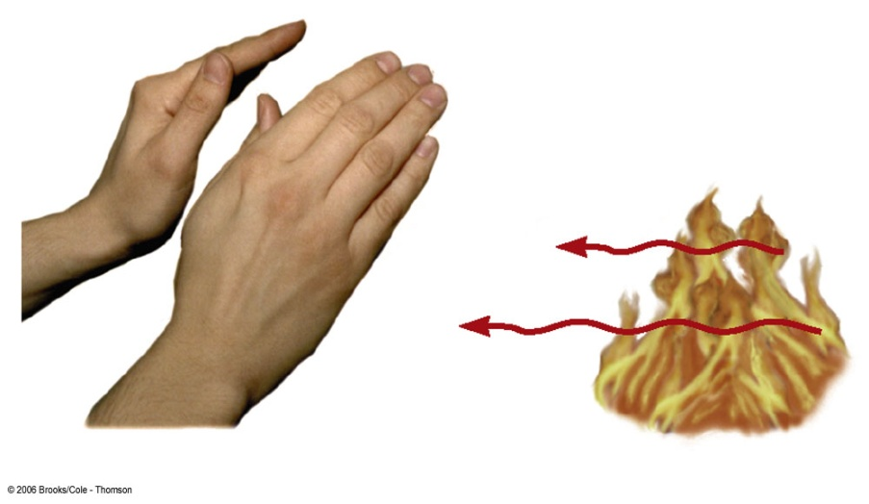
Radiation example
The electromagnetic waves carry the energy from the fire to the hands
No physical contact is necessary
Cannot be accounted for by conduction or convection

Slide 62
Radiation equation
The power is the rate of energy transfer, in Watts
σ = 5.6696 x 10⁻⁸ W/m^{2.}K⁴
A is the surface area of the object
e is a constant called the emissivity
e varies from 0 to 1
T is the temperature in Kelvins

Slide 63
Energy Absorption and Emission by Radiation
With its surroundings, the rate at which the object at temperature T with surroundings at T_{o} radiates is
When an object is in equilibrium with its surroundings, it radiates and absorbs at the same rate
Its temperature will not change

Slide 64
Ideal Absorbers
An ideal absorber is defined as an object that absorbs all of the energy incident on it
e = 1
This type of object is called a black body
An ideal absorber is also an ideal radiator of energy

Slide 65
Ideal Reflector
An ideal reflector absorbs none of the energy incident on it
e = 0

Slide 66
Applications of Radiation
Clothing
Black fabric acts as a good absorber
White fabric is a better reflector
Thermography
The amount of energy radiated by an object can be measured with a thermograph
Body temperature
Radiation thermometer measures the intensity of the infrared radiation from the eardrum

Slide 67
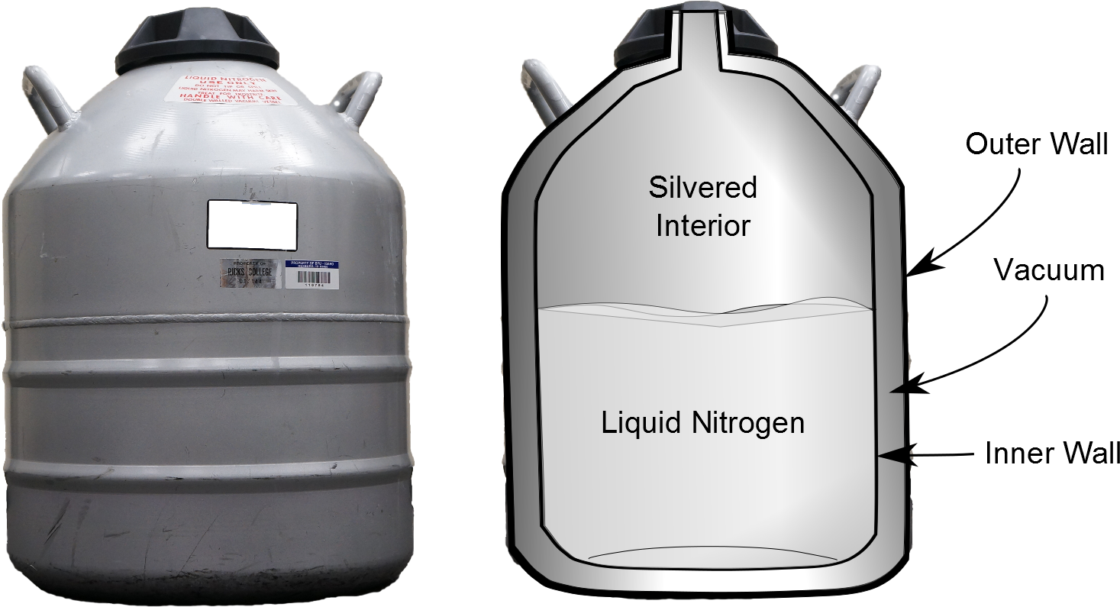
Resisting Energy Transfer
Dewar flask/thermos bottle
Designed to minimize energy transfer to surroundings
Space between walls is evacuated to minimize conduction and convection
Silvered surface minimizes radiation
Neck size is reduced

Slide 68
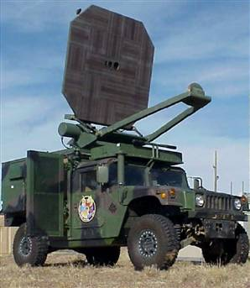
Radiation Example
Developed by the Air Force, the so-called "Active Denial System" (ADS) fires out milimeter waves -- a sort of cousin of microwaves, in the 95 GHz range. The invisible beams penetrate just a 64th of inch beneath the skin. But that's deep enough to heat up the water inside a person. Which is enough to cause excruciating pain.
http://www.defensetech.org/archives/002035.html

Slide 69
Global Warming
Greenhouse example
Visible light is absorbed and re-emitted as infrared radiation
Convection currents are inhibited by the glass
Earth’s atmosphere is also a good transmitter of visible light and a good absorber of infrared radiation
The Earth’s radiation budget (whether we have a positive or negative amount of energy transfer is hotly debated

Slide 70
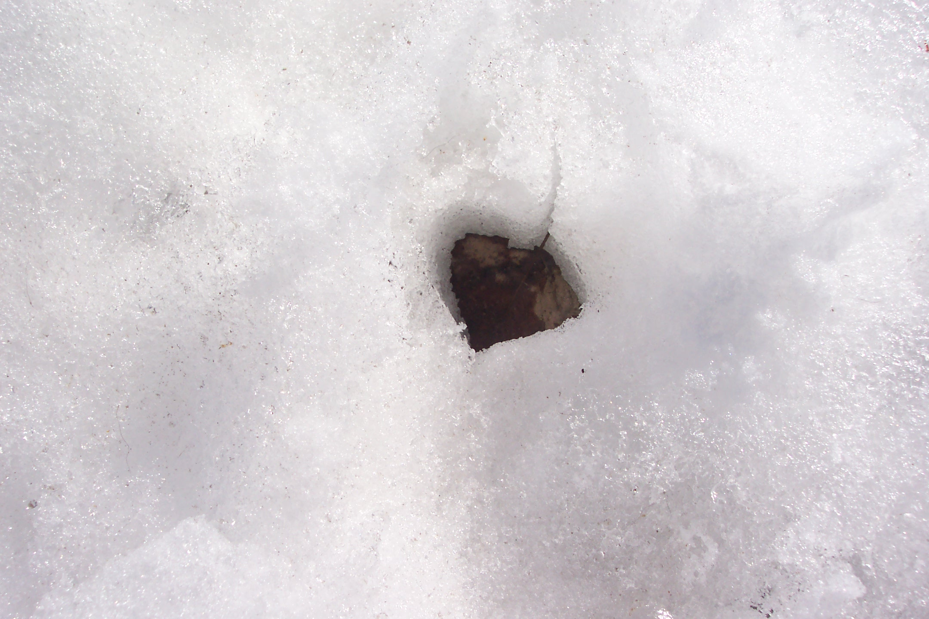
Question 123.13.5
You go outside on a cold spring morning in Rexburg. You see a leaf in the snow
The leaf seems to have sunk in the snow. What is the most likely reason for this?
The leaf is very massive so the force of gravity pulls it through the snow
The leaf has a different emissivity than the snow, so it absorbs more radiation from the sun, the temperature of the leaf rises and it melts the snow around it.
There was a very carful dog that stepped on the leaf, smashing it into the snow.

